Slide 1


Slide 2
MODULE 1

Slide 3
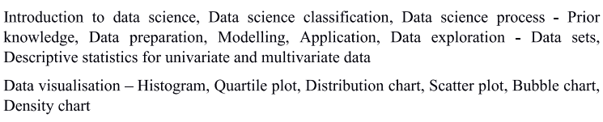
Syllabus

Slide 4
INTRODUCTION

Slide 5
Data Science
Data science is a collection of techniques used to extract value from data.
Data science techniques rely on finding useful patterns, connections, and relationships within data.
Data science is also commonly referred to as knowledge discovery, machine learning, predictive analytics, and data mining.
The use of the term science in data science indicates that the methods are evidence based, and are built on empirical knowledge, more specifically historical observations.
Artificial intelligence, Machine learning, and data science are all related to each other.

Slide 6
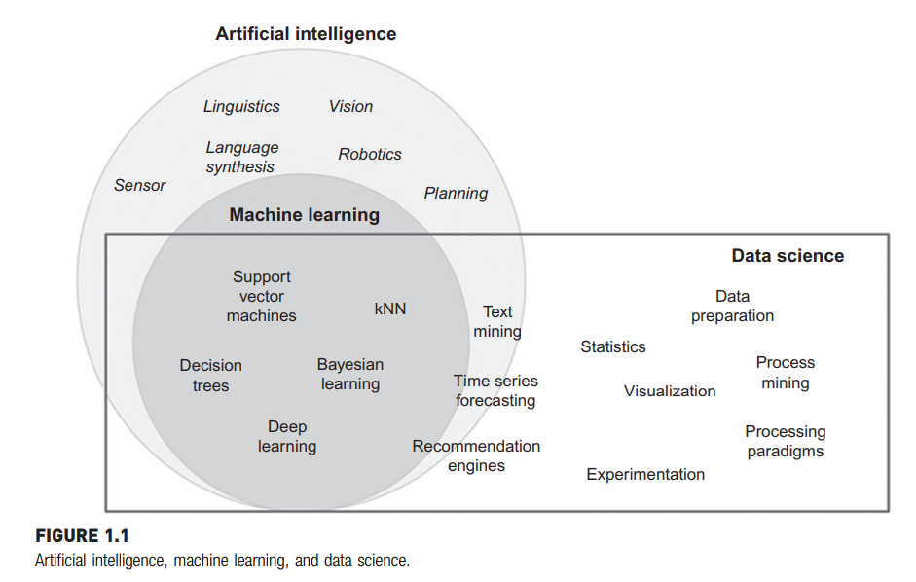

Slide 7
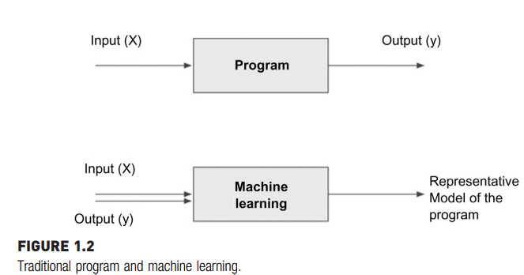
Artificial intelligence is about giving machines the capability of mimicking human behaviour. Examples would be: facial recognition, automated driving etc.
Machine learning can either be considered a sub-field or one of the tools of artificial intelligence, is providing machines with the capability of learning from experience. Experience for machines comes in the form of data. Data that is used to teach machines is called training data.
Machine learning algorithms, also called “learners”, take both the known input and output (training data) to figure out a model for the program which converts input to output.

Slide 8
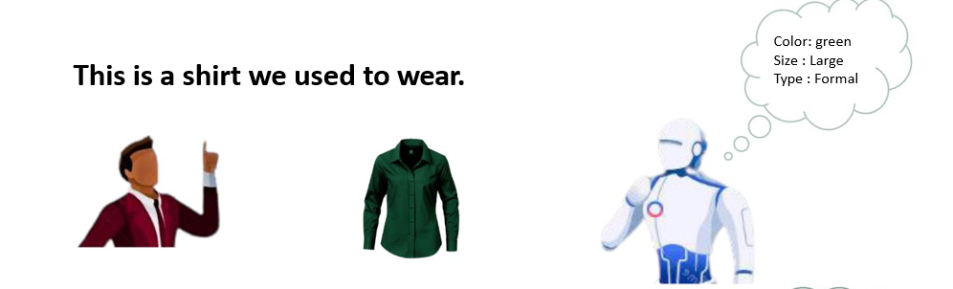
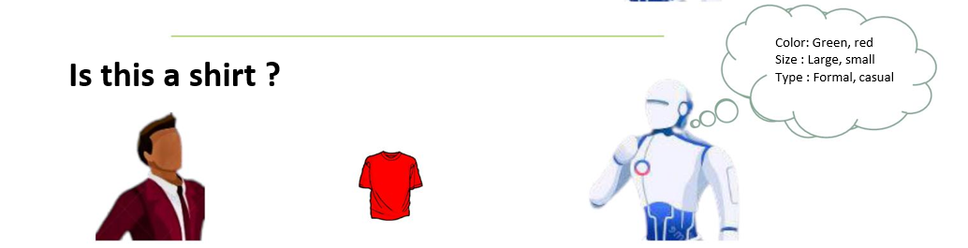
OK
This is also shirt

Slide 9
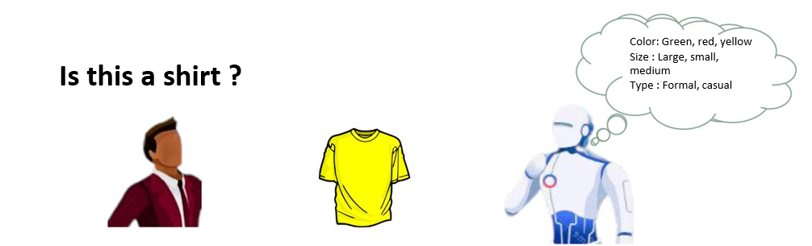
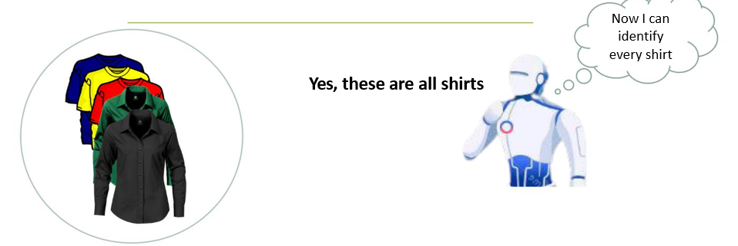
ok
This is also shirt

Slide 10
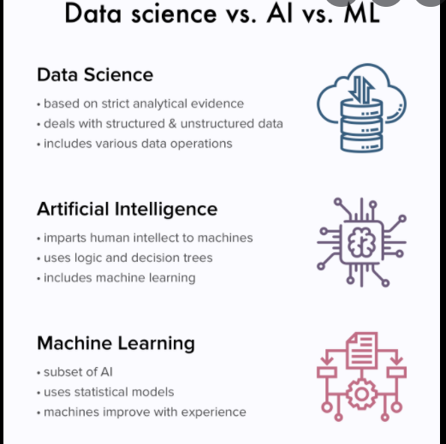

Slide 11
What is Data Science
Data science is the business application of machine learning, artificial intelligence, and other quantitative fields like statistics, visualization, and mathematics.
In the context of how data science is used today, it relies heavily on machine learning and is sometimes called data mining.
Examples of data science user cases are: recommendation engines that can recommend movies for a particular user, a fraud alert model that detects fraudulent credit card transactions or predict revenue for the next quarter.
Data science starts with data, which can range from a simple array of a few numeric observations to a complex matrix of millions of observations with thousands of variables. Data science utilizes certain specialized computational methods in order to discover meaningful and useful structures within a dataset.

Slide 12
Key features and motivations:-
Extracting Meaningful Patterns
Knowledge discovery in databases is the nontrivial process of identifying valid, novel, potentially useful, and ultimately understandable patterns or relationships within a dataset in order to make important decisions.
The ultimate objective of data science is to find potentially useful conclusions that can be acted upon by the users of the analysis.

Slide 13
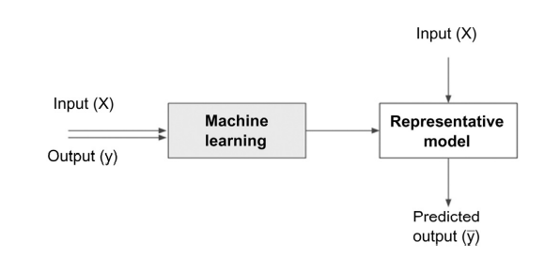
2.Building Representative Models
A model is the representation of a relationship between variables in a dataset. It describes how one or more variables in the data are related to other variables.

Slide 14
3. Combination of Statistics, Machine Learning, and Computing
In the pursuit of extracting useful and relevant information from large datasets, data science borrows computational techniques from the disciplines of statistics, machine learning, experimentation, and database theories.
One of the key ingredients of successful data science is substantial prior knowledge about the data and the business processes that generate the data, known as subject matter expertise.
4. Learning Algorithms
Data science as a process of discovering previously unknown patterns in data using automatic iterative methods. The application of sophisticated learning algorithms for extracting useful patterns from data differentiates data science from traditional data analysis techniques.
Each data science task uses specific learning algorithms like decision trees, neural networks, k-nearest neighbors (k-NN), and k-means clustering, etc

Slide 15
5.Associated Fields
Descriptive statistics: Computing mean, standard deviation, correlation, and other descriptive statistics, quantify the aggregate structure of a dataset. This is essential information for understanding any dataset in order to understand the structure of the data and the relationships within the dataset.
Exploratory visualization: The process of expressing data in visual coordinates enables users to find patterns and relationships in the data and to comprehend large datasets. Similar to descriptive statistics, they are integral in the pre- and post-processing steps in data science.

Slide 16
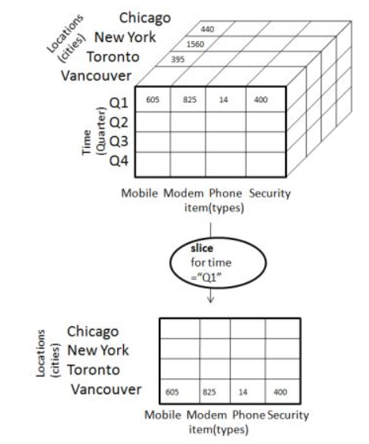
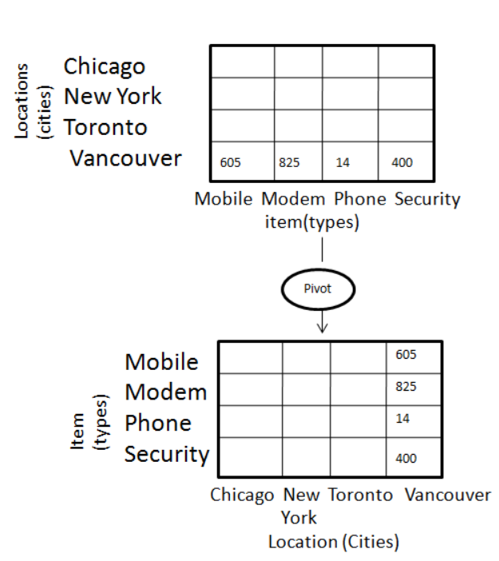
Dimensional slicing: Online analytical processing (OLAP) applications, mainly provide information on the data through dimensional slicing, filtering, and pivoting
slicing pivoting

Slide 17
Hypothesis testing: It is a statement or assumption that is either true or false. In general, data science is a process where many hypotheses are generated and tested based on observational data.
Data engineering: Data engineering is the process of sourcing, organizing, assembling, storing, and distributing data for effective analysis and usage.
Business intelligence: Business intelligence helps organizations consume data effectively. Business intelligence (BI) refers to the procedural and technical infrastructure that collects, stores, and analyzes the data produced by a company’s activities.

Slide 18
DATA SCIENCE CLASSIFICATION
Data science problems can be broadly categorized into
supervised or unsupervised learning models.
Supervised Models
Supervised or directed data science tries to infer a function or relationship based on labeled training data and uses this function to map new unlabeled data.
Supervised techniques predict the value of the output variables based on a set of input variables.
To do this, a model is developed from a training dataset where the values of input and output are previously known.
The model generalizes the relationship between the input and output variables and uses it to predict for a dataset where only input variables are known.
The output variable that is being predicted is also called a class label or target variable

Slide 19
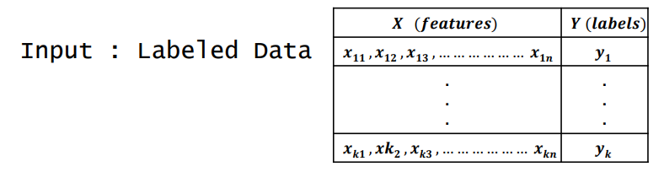
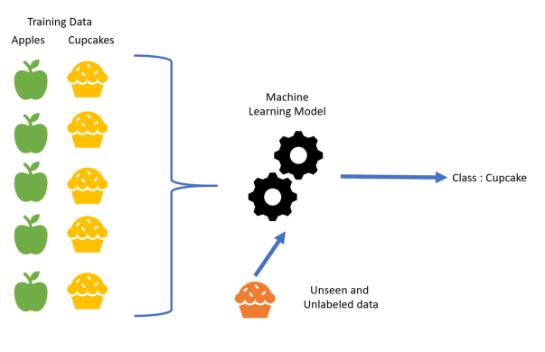

Slide 20
Unsupervised Models
Unsupervised or undirected data science uncovers hidden patterns in unlabeled data.
In unsupervised data science, there are no output variables to predict.
The objective of this class of data science techniques, is to find patterns in data based on the relationship between data points themselves

Slide 21
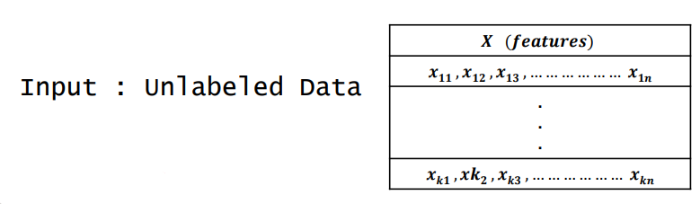
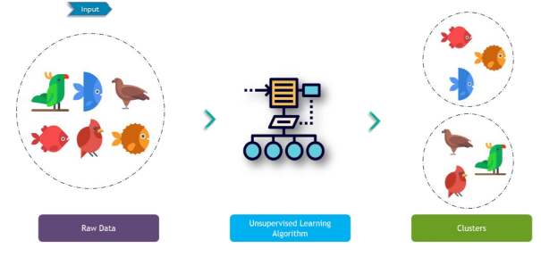

Slide 22
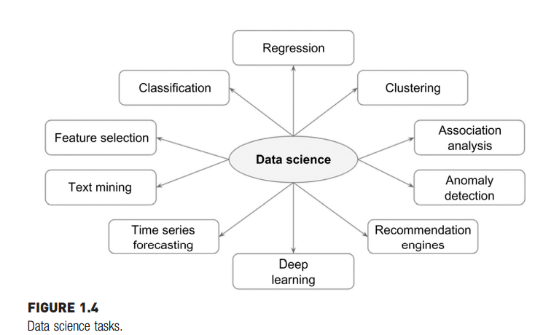

Slide 23
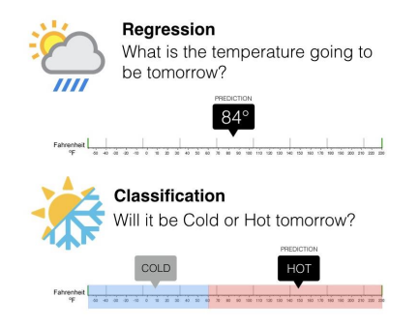
Classification and regression techniques predict a target variable based on input variables.
The prediction is based on a generalized model built from a previously known dataset. In regression tasks, the output variable is numeric. Classification tasks predict output variables, which are categorical.
Deep learning is a more sophisticated artificial neural network that is increasingly used for classification and regression problems.

Slide 24
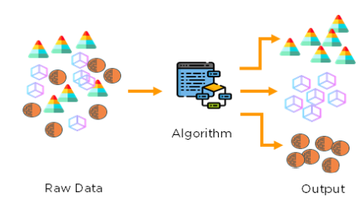
Clustering is the process of identifying the natural groupings in a dataset.

Slide 25
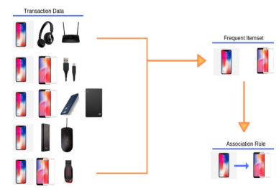
In retail analytics, it is common to identify pairs of items that are purchased together, so that specific items can be bundled or placed next to each other. This task is called market basket analysis or association analysis.

Slide 26

Recommendation engines are the systems that recommend items to the users based on individual user preference.
Anomaly or outlier detection identifies the data points that are significantly different from other data points in a dataset.

Slide 27
Time series forecasting is the process of predicting the future value of a variable (e.g., temperature) based on past historical values.
Text mining is a data science application where the input data is text, which can be in the form of documents, messages, emails, or web pages. To aid the data science on text data, the text files are first converted into document vectors where each unique word is an attribute. Once the text file is converted to document vectors, standard data science tasks such as classification, clustering, etc., can be applied.

Slide 28
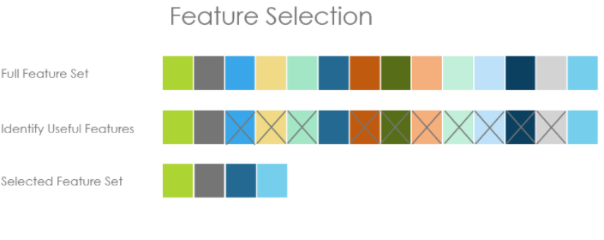
Feature selection is a process in which attributes in a dataset are reduced to a few attributes that really matter.

Slide 29
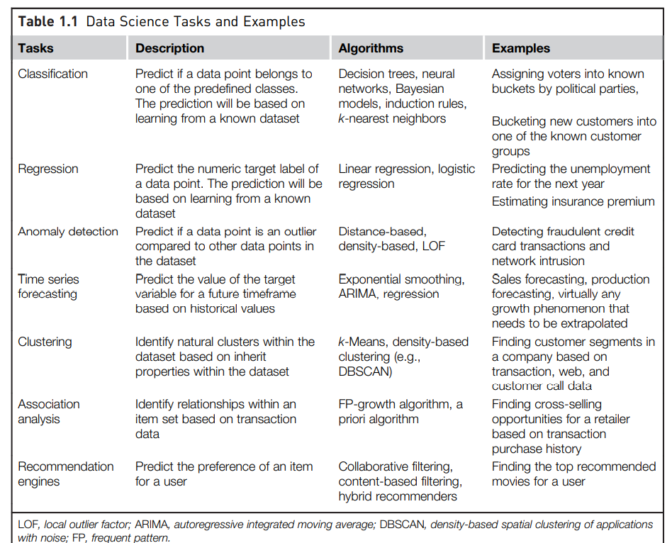

Slide 30
A complete data science application can contain elements of both supervised and unsupervised techniques .
Unsupervised techniques provide an increased understanding of the dataset and hence, are sometimes called descriptive data science

Slide 31
DATA SCIENCE PROCESS

Slide 32
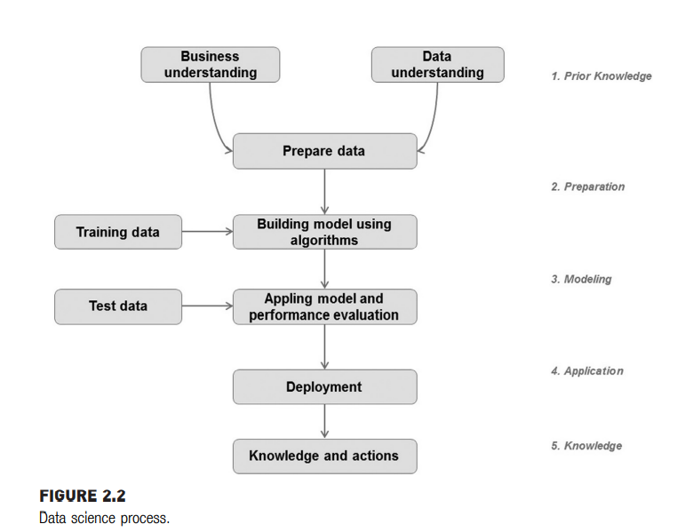
The methodical discovery of useful relationships and patterns in data is enabled by a set of iterative activities collectively known as the data science process.

Slide 33
PRIOR KNOWLEDGE
Prior knowledge refers to information that is already known about a subject.
The prior knowledge step in the data science process helps to define what problem is being solve and what data is needed in order to solve the problem.
Objective:Without a well-defined statement of the problem, it is impossible to come up with the right dataset and pick the right data science algorithm.
Subject Area:The process of data science uncovers hidden patterns in the dataset by exposing relationships between attributes. But the problem is that it uncovers a lot of patterns. The false signals are a major problem in the data science process. . Hence, it is essential to know the subject matter, the context, and the business process generating the data.
Data:Similar to the prior knowledge in the subject area, prior knowledge in the data can also be gathered. Understanding how the data is collected, stored, transformed, reported, and used is essential to the data science process.

Slide 34
A dataset is a collection of data with a defined structure.
This structure is also sometimes referred to as a “data frame”.
● A data point (record, object) is a single instance in the dataset. Each instance contains the same structure as the dataset.
● An attribute (feature, input, dimension, variable, or predictor) is a single property of the dataset. Attributes can be numeric, categorical, date-time, text, or Boolean data types.
A label (class label, output, prediction, target, or response) is the special attribute to be predicted based on all the input attributes. In Table interest rate is the output variable.
● Identifiers are special attributes that are used for locating or providing context to individual records. For example, common attributes like names, account numbers, and employee ID numbers are identifier attributes. Identifiers are often used as lookup keys to join multiple datasets

Slide 35
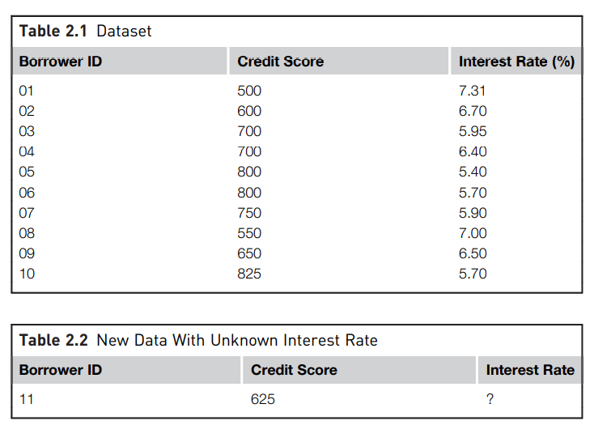

Slide 36
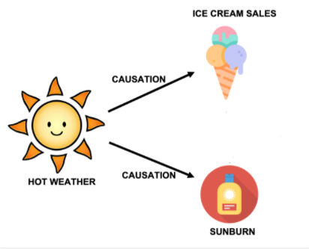
Causation Versus Correlation:Correlation is a statistical measure (expressed as a number) that describes the size and direction of a relationship between two or more variables.
Causation indicates that one event is the result of the occurrence of the other event; i.e. there is a causal relationship between the two events. This is also referred to as cause and effect.

Slide 37
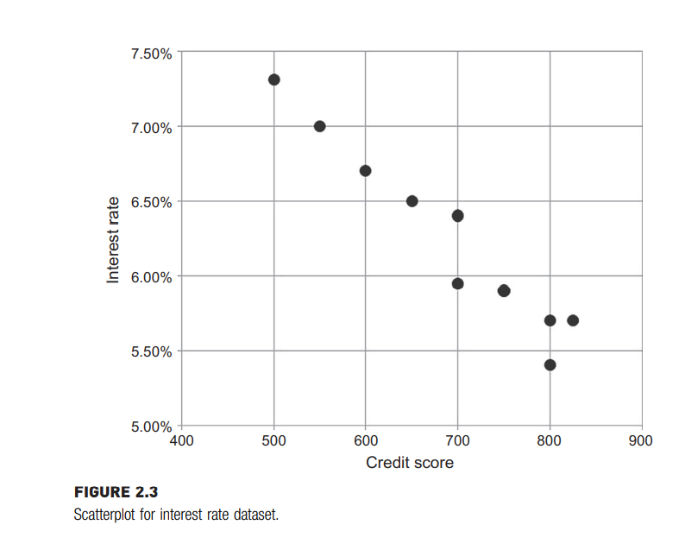
DATA PREPARATION
Preparing the dataset to suit a data science task is the most time-consuming part of the process. It is extremely rare that datasets are available in the form required by the data science algorithms.
1.Data Exploration:Data exploration, also known as exploratory data analysis, provides a set of simple tools to achieve basic understanding of the data. Data exploration approaches involve computing descriptive statistics and visualization of data.

Slide 38
2.Data Quality:Data quality is an ongoing concern wherever data is collected, processed, and stored.
Organizations use data alerts, cleansing, and transformation techniques to improve and manage the quality of the data and store them in companywide repositories called data warehouses.
Data sourced from well-maintained data warehouses have higher quality, as there are proper controls in place to ensure a level of data accuracy for new and existing data.
The data cleansing practices include elimination of duplicate records, quarantining outlier records that exceed the bound, substitution of missing values, etc.

Slide 39
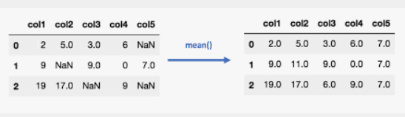
3. Missing Values
One of the most common data quality issues is that some records have missing attribute values. For example, a credit score may be missing in one of the records.
The first step of managing missing values is to understand the reason behind why the values are missing.
The missing value can be substituted with a range of artificial data so that the issue can be managed.
Missing credit score values can be replaced with a credit score derived from the dataset (mean, minimum, or maximum value, depending on the characteristics of the attribute).

Slide 40
4. Data Types and Conversion
The attributes in a dataset can be of different types, such as continuous numeric (interest rate), integer numeric (credit score), or categorical.
For example, the credit score can be expressed as categorical values (poor, good, excellent) or numeric score. Different data science algorithms impose different restrictions on the attribute data types.
If the available data are categorical, they must be converted to continuous numeric attribute. A specific numeric score can be encoded for each category value, such as poor=400, good=600, excellent=700, etc.
Numeric values can be converted to categorical data types by a technique called binning

Slide 41
5.Transformation
In some data science algorithms , the input attributes are expected to be numeric and normalized.
Normalization prevents one attribute dominating the results because of large values.
For example, consider income (expressed in USD, in thousands) and credit score (in hundreds). One solution is to convert the range of income and credit score to a more uniform scale from 0 to 1 by normalization.

Slide 42
6. Outliers
Outliers are anomalies in a given dataset. Outliers may occur because of correct data capture (few people with income in tens of millions) or erroneous data capture (human height as 1.73 cm instead of 1.73 m). Presence of outliers needs to be require special treatments.
Detecting outliers may be the primary purpose of some data science applications, like fraud or intrusion detection.

Slide 43
7.Feature Selection
Many data science problems involve a dataset with hundreds to thousands of attributes.
Not all the attributes are equally important or useful in predicting the target.
Some of the attributes may be highly correlated with each other, like annual income and taxes paid.
A large number of attributes in the dataset significantly increases the complexity of a model and may degrade the performance of the model.
Reducing the number of attributes, without significant loss in the performance of the model, is called feature selection.

Slide 44
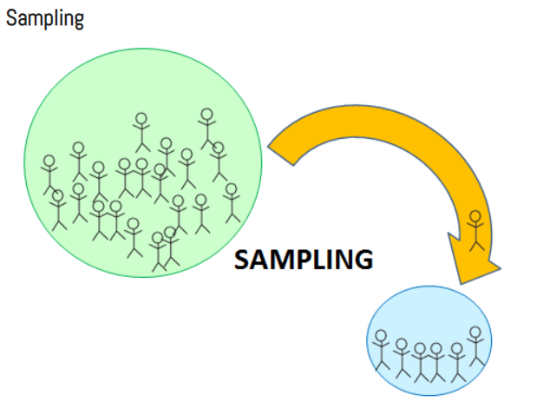
8.Data Sampling
Sampling is a process of selecting a subset of records as a representation of the original dataset for use in data analysis or modeling. The sample data serve as a representative of the original dataset with similar properties. Sampling reduces the amount of data that need to be processed and speeds up the build process of the modeling.
In the build process for data science applications, it is necessary to segment the datasets into training and test samples. The training dataset is sampled from the original dataset using simple sampling.
Stratified sampling is a process of sampling where each class is equally represented in the sample.

Slide 45
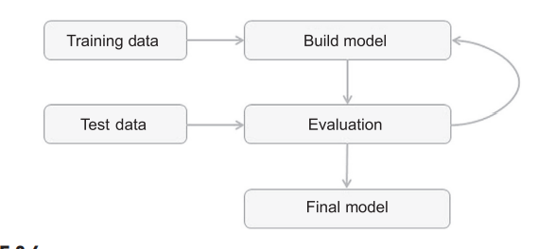
Modelling
A model is the abstract representation of the data and the relationships in a given dataset.

Slide 46
Training and Testing Datasets
The dataset used to create the model, with known attributes and target, is called the training dataset.
The validity of the created model will also need to be checked with another known dataset called the test dataset or validation dataset.
To facilitate this process, the overall known dataset can be split into a training dataset and a test dataset.
A standard rule of thumb is two-thirds of the data are to be used as training and one-third as a test dataset

Slide 47
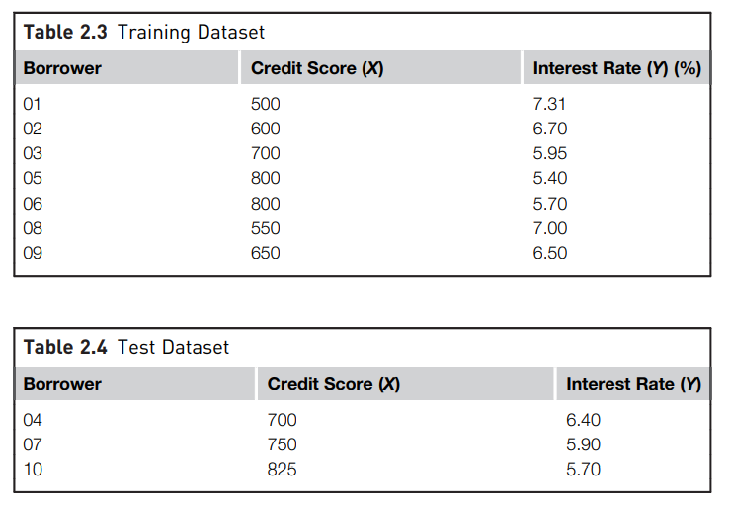

Slide 48
2.Learning Algorithms
The business question and the availability of data will dictate what data science task (association, classification, regression, etc.,) can to be used.
The practitioner determines the appropriate data science algorithm within the chosen category.
For example, within a classification task many algorithms can be chosen from: decision trees, rule induction, neural networks, Bayesian models, k-NN, etc.

Slide 49
2. Evaluation of the Model
Model evaluation is used to test the performance of the model.
Training set is used for the purpose of model building and test set is used to test the performance of the model.
The estimation may not be exactly the same as the values in the training records. The phenomenon of a model memorizing the training data is called overfitting.
An overfitted model just memorizes the training records and will underperform on real unlabeled new data.
The model should generalize or learn the relationship between credit score and interest rate. To evaluate this relationship, the validation or test dataset, which was not previously used in building the model, is used for evaluation.

Slide 50
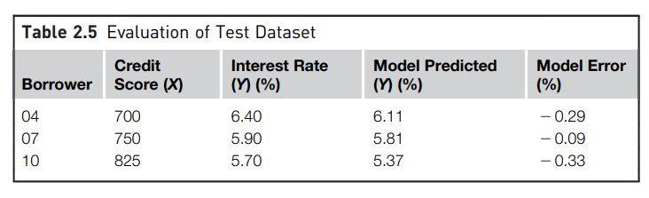

Slide 51
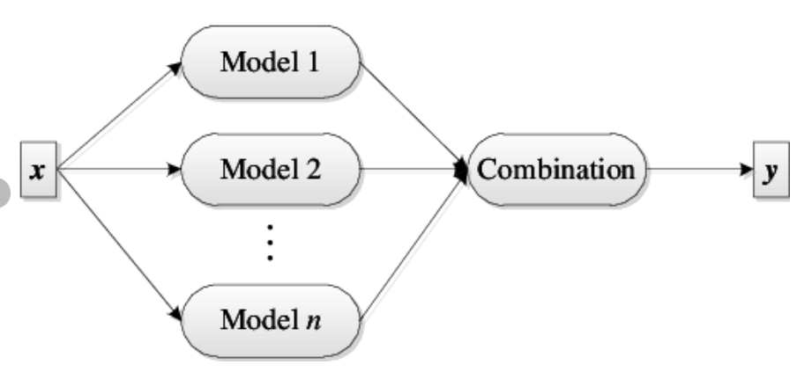
3.Ensemble Modeling
Ensemble modeling is a process where multiple diverse base models are used to predict an outcome.
The motivation for using ensemble models is to reduce the generalization error of the prediction.
As long as the base models are diverse and independent, the prediction error decreases when the ensemble approach is used.

Slide 52
APPLICATION
Deployment is the stage at which the model becomes production ready or live.
The model deployment stage has to deal with: assessing model readiness, technical integration, response time, model maintenance, and assimilation.
Production Readiness
The production readiness part of the deployment determines the critical qualities required for the deployment objective.
Consider two business use cases:
i)determining whether a consumer qualifies for a loan- critical quality of this model deployment is real-time prediction
ii)determining the groupings of customers for an enterprise by marketing function- critical quality in this application is the ability to find unique patterns amongst customers, not the response time of the model.

Slide 53
2. Technical Integration
Currently, it is quite common to use data science automation tools or coding using R or Python to develop models.
It is flexible to develop the model with one tool and deploy it in another tool or application.
Some models such as simple regression, decision trees, and induction rules for predictive analytics can be incorporated directly into business applications and business intelligence systems easily.

Slide 54
3.Response Time
Data science algorithms, like k-NN, are easy to build, but quite slow at predicting the unlabeled records.
Algorithms such as the decision tree take time to build but are fast at prediction.
The quality of prediction, accessibility of input data, and the response time of the prediction remain the critical quality factors in business application

Slide 55
4.Model Refresh
It is quite normal that the conditions in which the model is built change after the model is sent to deployment.
For example, the relationship between the credit score and interest rate change frequently based on the prevailing macroeconomic conditions. Hence, the model will have to be refreshed frequently.
The validity of the model can be routinely tested by using the new known test dataset and calculating the prediction error rate.
If the error rate exceeds a particular threshold, then the model has to be refreshed and redeployed.

Slide 56
5.Assimilation
In the descriptive data science applications, deploying a model to live systems may not be the end objective.
The objective may be to assimilate the knowledge gained from the data science analysis to the organization.
For example, the objective may be finding logical clusters in the customer database so that separate marketing approaches can be developed for each customer cluster. Then the next step may be a classification task for new customers to bucket them in one of known clusters.
The association analysis provides a solution for the market basket problem, where the task is to find which two products are purchased together most often.

Slide 57
KNOWLEDGE
The data science process provides a framework to extract nontrivial information from data.
With the advent of massive storage, increased data collection, and advanced computing paradigms, the available datasets to be utilized are only increasing.
To extract knowledge from these massive data assets, advanced approaches need to be employed, like data science algorithms, in addition to standard business intelligence reporting or statistical analysis.
Though many of these algorithms can provide valuable knowledge, it is up to the practitioner to skillfully transform a business problem to a data problem and apply the right algorithm.
Data science, like any other technology, provides various options in terms of algorithms. Using these options to extract the right information from data .

